Slide 1


Monthly Expenditure Analysis
CAP776
CA1 : Group Presentation
Submitted by :
Submitted to :
Mr. Girish Kumar
Ram Krishna Pandey (12300329)
Kaushik Pathak (12325859)
Shruti Tyagi (12317494)
Prachi (12320539)

Slide 2
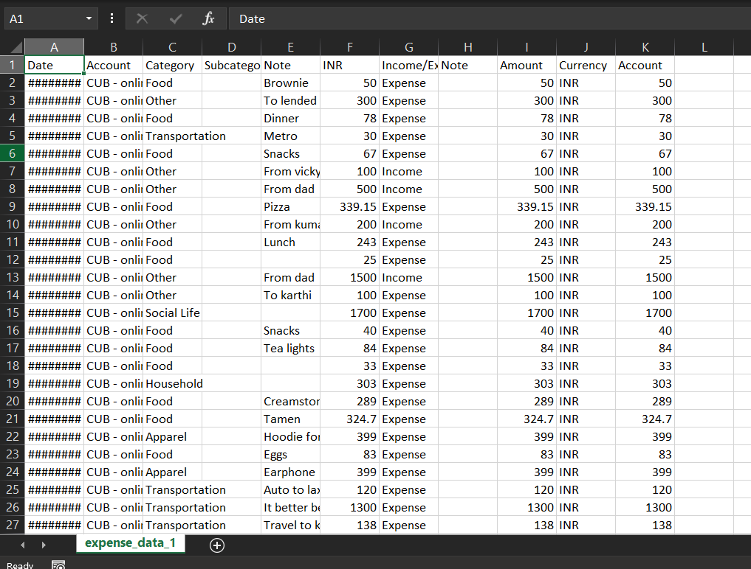
Expenditure Dataset
Date
Account
Category
Sub category
Note
INR
Income Expenditure
Amount
Currency

Slide 3
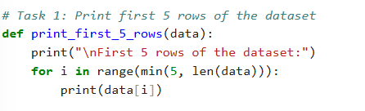
Printing head
def print_first_5_rows(data):
print("\nFirst 5 rows of the dataset:")
for i in range(min(5, len(data))):
print(data[i])

Slide 4
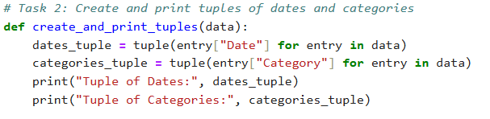
Creating and printing tuples
def create_and_print_tuples(data):
dates_tuple = tuple(entry["Date"] for entry in data)
categories_tuple = tuple(entry["Category"] for entry in data)
print("Tuple of Dates:", dates_tuple)
print("Tuple of Categories:", categories_tuple)

Slide 5
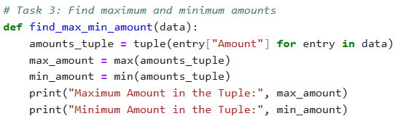
Find maximum and minimum amounts
def find_max_min_amount(data):
amounts_tuple = tuple(entry["Amount"] for entry in data)
max_amount = max(amounts_tuple)
min_amount = min(amounts_tuple)
print("Maximum Amount in the Tuple:", max_amount)
print("Minimum Amount in the Tuple:", min_amount)

Slide 6
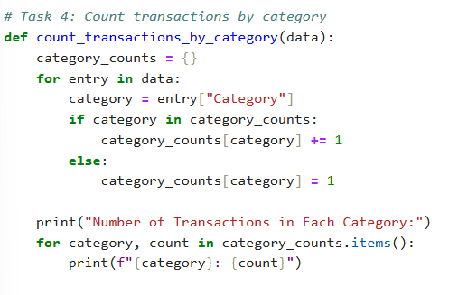
Count transaction by category
def count_transactions_by_category(data):
category_counts = {}
for entry in data:
category = entry["Category"]
if category in category_counts: category_counts[category] += 1
else:
category_counts[category] = 1
print("Number of Transactions in Each Category:")
for category, count in category_counts.items(): print(f"{category}: {count}")

Slide 7
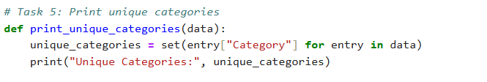
Print unique categories
def print_unique_categories(data):
unique_categories = set(entry["Category"] for entry in data)
print("Unique Categories:", unique_categories)

Slide 8
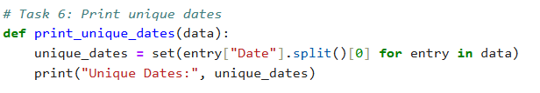
Print unique dates
def print_unique_dates(data):
unique_dates = set(entry["Date"].split()[0] for entry in data)
print("Unique Dates:", unique_dates)

Slide 9
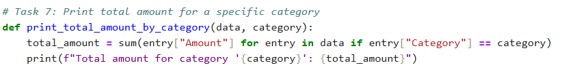
Printing total amount for a specific category
def print_total_amount_by_category(data, category):
total_amount = sum(entry["Amount"] for entry in data if entry["Category"] == category)
print(f"Total amount for category '{category}': {total_amount}")

Slide 10
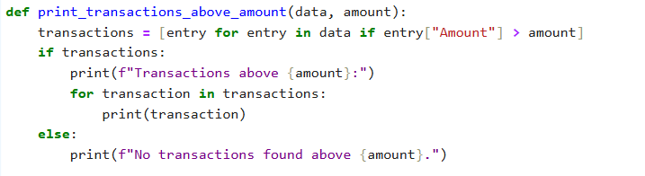
Finding transactions above a certain amount
def print_transactions_above_amount(data, amount):
transactions = [entry for entry in data if entry["Amount"] > amount]
if transactions:
print(f"Transactions above {amount}:")
for transaction in transactions:
print(transaction)
else:
print(f"No transactions found above {amount}.")

Slide 11
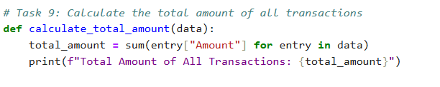
Finding transactions above a certain amount
def calculate_total_amount(data):
total_amount = sum(entry["Amount"] for entry in data)
print(f"Total Amount of All Transactions: {total_amount}")

Slide 12
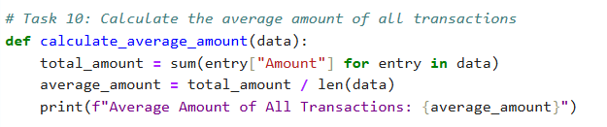
Calculate the average amount of all transactions
def calculate_average_amount(data):
total_amount = sum(entry["Amount"] for entry in data)
average_amount = total_amount / len(data)
print(f"Average Amount of All Transactions: {average_amount}")

Slide 13
elif choice == '4':
count_transactions_by_category(data)
elif choice == '5':
print_unique_categories(data)
elif choice == '6':
print_unique_dates(data)
elif choice == '7':
category = input("Enter the category: ")
print_total_amount_by_category(data, category)
elif choice == '8':
amount = float(input("Enter the amount: "))
print_transactions_above_amount(data, amount)
elif choice == '9':
calculate_total_amount(data)
elif choice == '10':
calculate_average_amount(data)
elif choice == '11':
print("Exiting the program.")
break
else:
print("Invalid choice. Please enter a number between 1 and 11.")
# Run the main function
if __name__ == "__main__": main()
def main():
header, data = load_data()
while True:
print("\nMenu:")
print("1. Print first 5 rows of the dataset")
print("2. Create and print tuples of dates and categories")
print("3. Find maximum and minimum amounts")
print("4. Count transactions by category")
print("5. Print unique categories")
print("6. Print unique dates")
print("7. Print total amount for a specific category")
print("8. Find transactions above a certain amount")
print("9. Calculate the total amount of all transactions")
print("10. Calculate the average amount of all transactions")
print("11. Exit")
choice = input("Enter your choice (1-11): ")
if choice == '1':
print_first_5_rows(data)
elif choice == '2':
create_and_print_tuples(data)
elif choice == '3':
find_max_min_amount(data)

Slide 14
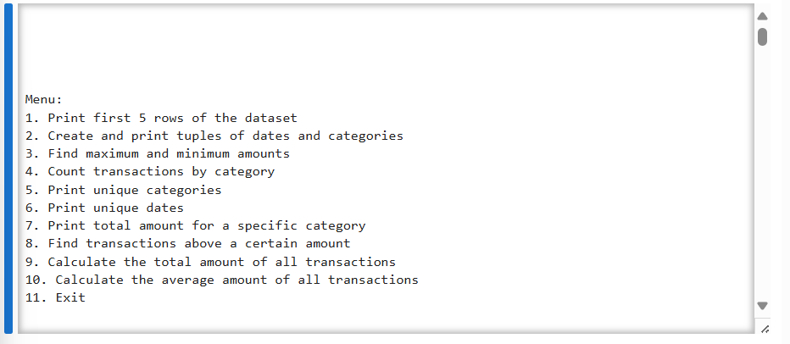
MENU

Slide 15
THANK YOU

